Slide 1
Accessing Remote Devices
Telnet

Slide 2
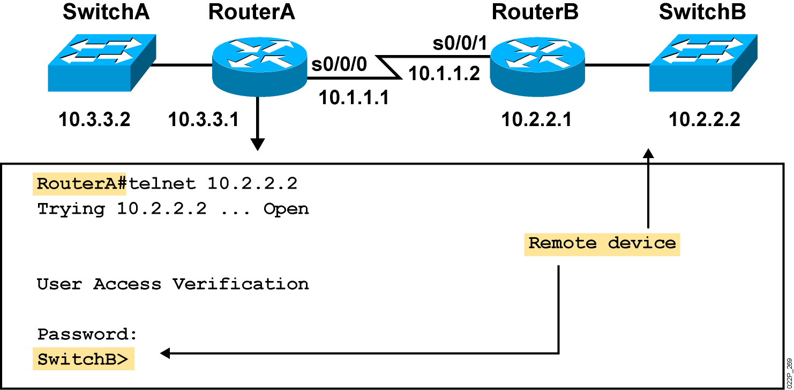
Using Telnet to Connect to Remote Devices
Notes:
Emphasize: Another way to learn about a remote device is to connect to it. Telnet, a virtual terminal protocol that is part of the TCP/IP protocol suite, allows connections to remote hosts. By default, a router can have up to five simultaneous incoming Telnet sessions. With Cisco’s implementation of TCP/IP, you need not enter the connect or telnet command to establish a Telnet connection. If you prefer, you can just enter the learned host name, and the router will resolve the host name using DNS or a local host table. To end a Telnet session, use the exit or logout EXEC command.
These are alternate commands for the operations listed on the graphic:
Initiate a session:
Denver> connect paris
Denver> paris
Denver> 131.108.100.152
Resume a session (enter session number or name):
Denver> 1
Paris>
End a session:
Paris> exit
Note: The Catalyst 1900 can accept incoming Telnet connections but cannot initiate an outgoing Telnet session.

Slide 3
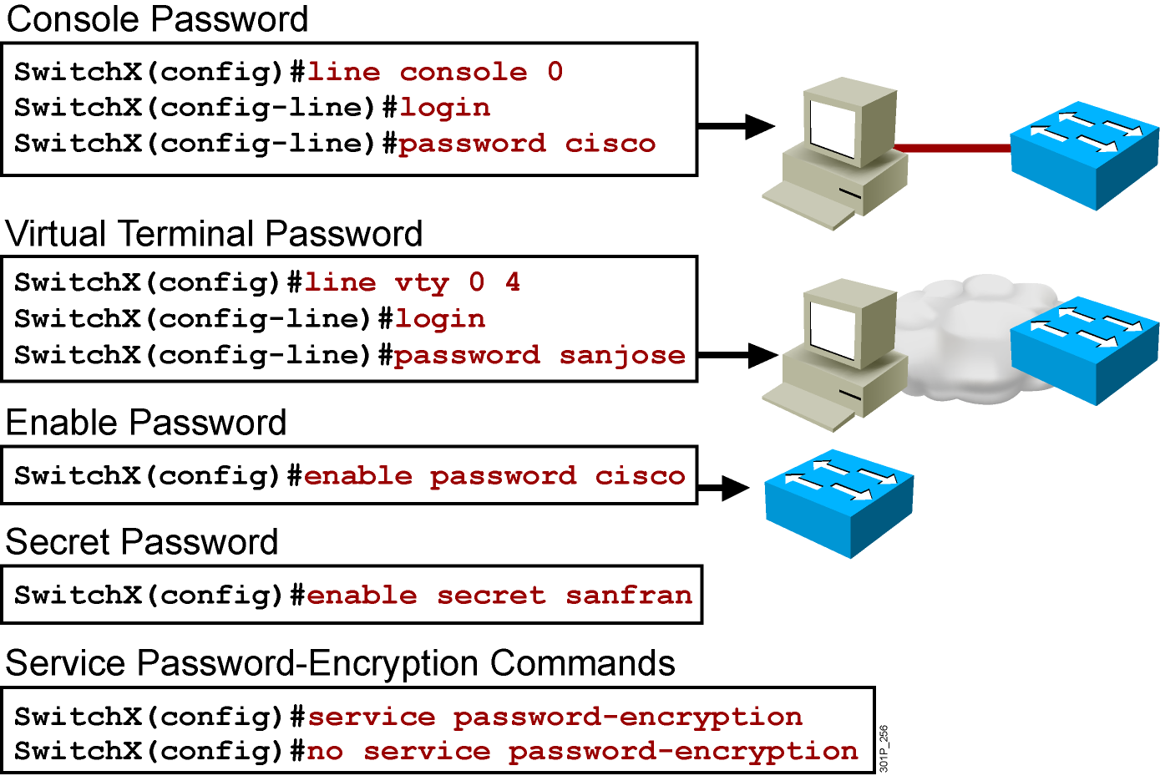
Configuring Telnet
Notes:
Layer 2 of 2
Emphasize: The router has one enable password. Remember that this is your only protection. Whoever owns this password can do anything with the router, so be careful about communicating this password to others. To provide an additional layer of security, particularly for passwords that cross the network or are stored on a TFTP server, you can use either the enable password or enable secret commands. Both commands accomplish the same thing; that is, they allow you to establish an encrypted password that users must enter to access enable mode (the default), or any privilege level you specify. Cisco recommends that you use the enable secret command because it uses an improved encryption algorithm. Use the enable password command only if you boot an older image of the Cisco IOS software, or if you boot older boot ROMs that do not recognize the enable secret command. If you configure the enable secret password, it is used instead of the enable password, not in addition to it.
Cisco supports password encryption. Turn on password encryption using the service password-encryption command. Then enter the desired passwords for encryption. Immediately, on the next line, enter the no service password-encryption command. Only those passwords that are set between the two commands will be encrypted. If you enter service password-encryption and then press Ctrl-Z to exit, all passwords will be encrypted.
Note: Password recovery is not covered in the course materials. Refer the students to the IMCR class.

Slide 4
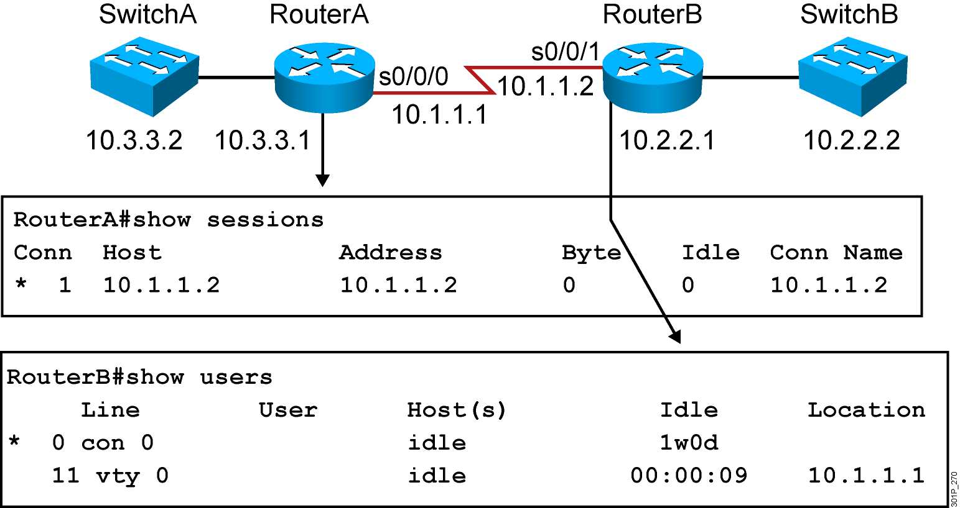
Viewing Telnet Connections
Notes:
Note: This output was taken from a 2522. Line 11 = vty 0.
You can send messages to one or all terminal lines. A common reason for doing this is to inform users of an impending shutdown. To send a message to other terminals, issue the following command:
send {line-number | *}
where line-number specifies the line number to which the message will be sent, and * indicates that the message will be sent to all lines.
The system prompts for the message, which can be up to 500 characters long. End the message by entering Ctrl-Z. Enter Ctrl-C to abort the command.

Slide 5
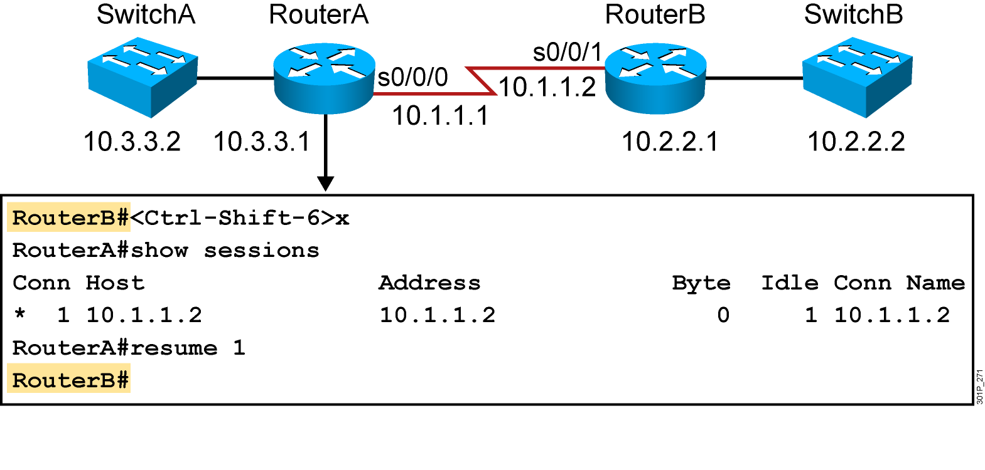
Suspending and Resuming a Telnet Session
Notes:
Emphasize: The key stroke sequence for Ctrl-Shift-6 and x.

Slide 6
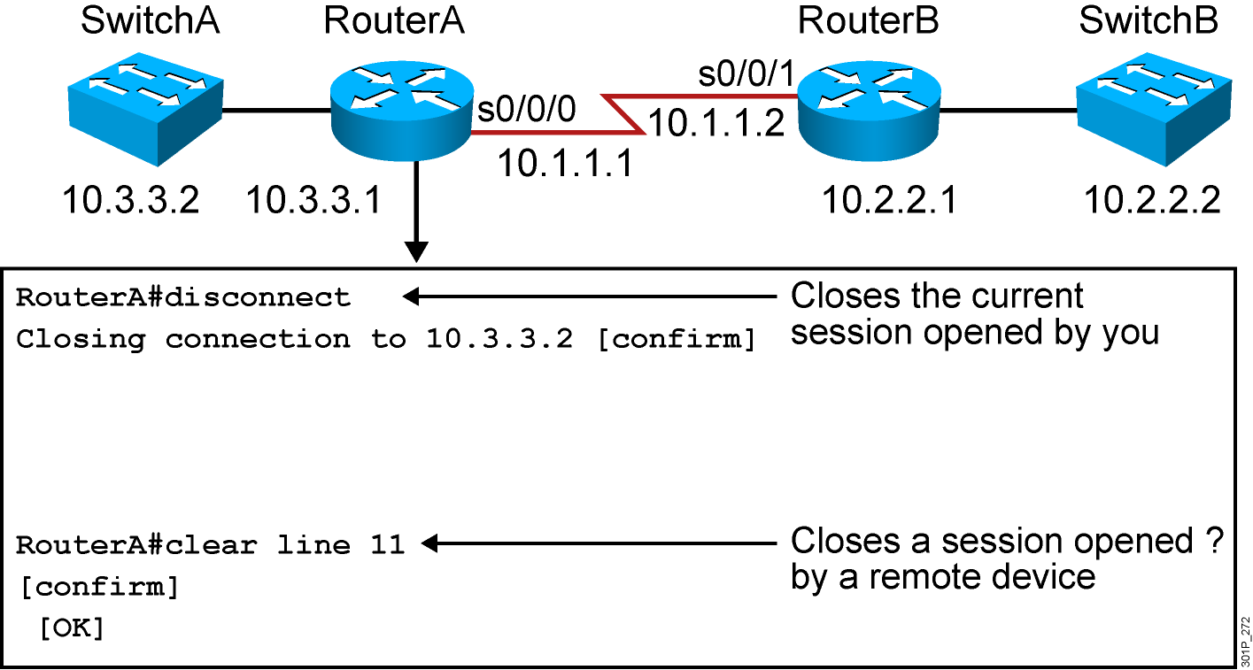
Closing a Telnet Session
Notes:
Note: Disconnecting without the session number disconnects that last active session.

Slide 7
Recovery Password

Slide 8
Router Power-On Boot Sequence
Perform power-on self-test (POST).
Load and run bootstrap code.
Find the Cisco IOS Software.
Load the Cisco IOS Software.
Find the configuration.
Load the configuration.
Run the configured Cisco IOS Software.
Notes:
Emphasize: In a later slide, there is a very detailed flowchart of the router startup process.

Slide 9
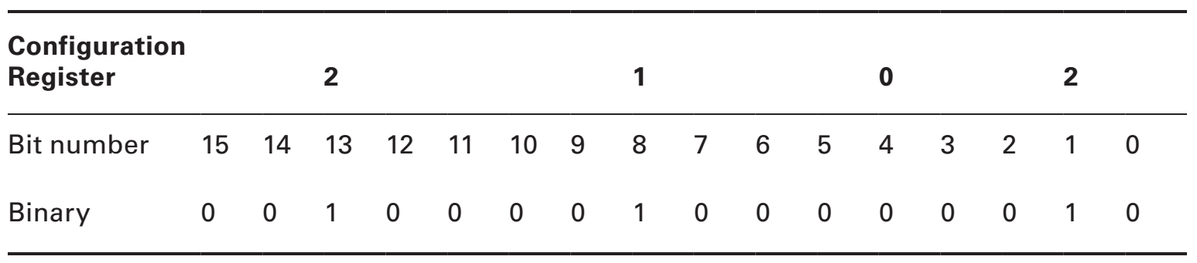
The configuration register bit numbers

Slide 10
Step by step recovery password
Power-off Router and wait 30s then turn it on
When you see the line “Readonly ROMMON initialized”, press Ctrl + Break
Set configuration register to 0x2142 and reboot the router
  rommon 1 > confreg 0x2142
  rommon 2 > reset
Copy startup-config running-config
Change all password and copy running-config startup-config
Set back the config-register to 0x2102
Router(config)#config-register 0x2102
Notes:
Note: There is a detailed flowchart of the router startup process on the next slide.

Slide 11
show version Command
Cisco IOS Software, 2800 Software (C2800NM-IPBASE-M), Version 12.4(5a), RELEASE SOFTWARE (fc3)
Technical Support: http://www.cisco.com/techsupport
Copyright (c) 1986-2006 by Cisco Systems, Inc.
Compiled Sat 14-Jan-06 03:19 by alnguyen
ROM: System Bootstrap, Version 12.4(1r) [hqluong 1r], RELEASE SOFTWARE (fc1)
RouterX uptime is 1 week, 5 days, 21 hours, 30 minutes
System returned to ROM by reload at 23:04:40 UTC Tue Mar 13 2007
System image file is "flash:c2800nm-ipbase-mz.124-5a.bin"
Cisco 2811 (revision 53.51) with 251904K/10240K bytes of memory.
Processor board ID FTX1013A1DJ
2 FastEthernet interfaces
2 Serial(sync/async) interfaces
DRAM configuration is 64 bits wide with parity enabled.
239K bytes of non-volatile configuration memory.
62720K bytes of ATA CompactFlash (Read/Write)
Configuration register is 0x2142 (will be 2102 at next reload)
Notes:
Note: The current state of the Flash memory is in read-only mode. It is running Cisco IOS from Flash.
This router has a total of 16 MB of Flash memory. The Flash contains one Cisco IOS image and there is 6.69 MB of available space left in Flash.

Slide 12
Managing Cisco Devices

Slide 13
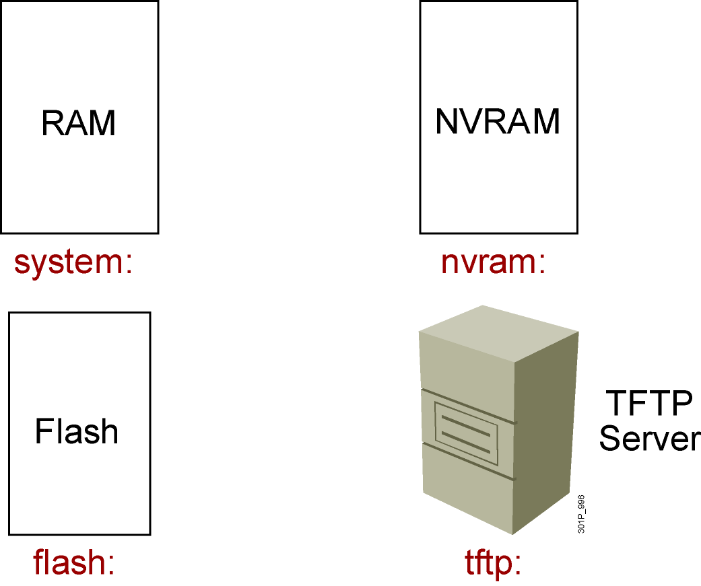
Cisco IOS File System and Devices
Notes:
Emphasize: In Cisco IOS Release 12.0, there are new copy commands. These new commands treat the RAM, Flash, NVRAM, TFTP, FTP, and so on as a file system. Since this class was developed when the most common Cisco IOS in the field is pre-12.0, these 12.0 commands are not covered in detail in this class.

Slide 14
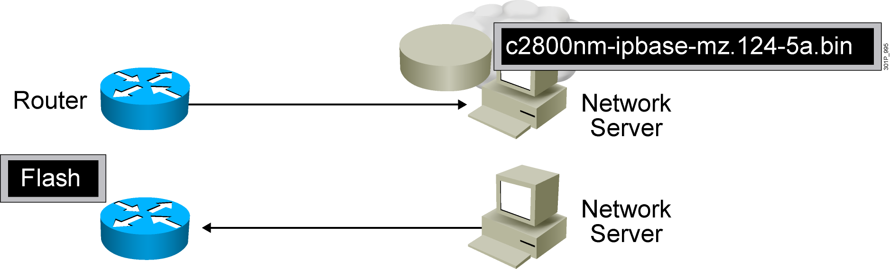
Managing Cisco IOS Images
Notes:
Emphasize: This section introduces topics on managing your configuration file and Cisco IOS image.

Slide 15
Verifying Memory and Deciphering Image Filenames
RouterX#show flash:
-#- --length-- -----date/time------ path
1 14951648 Feb 22 2007 21:38:56 +00:00 c2800nm-ipbase-mz.124-5a.bin
2 1823 Dec 14 2006 08:24:54 +00:00 sdmconfig-2811.cfg
3 4734464 Dec 14 2006 08:25:24 +00:00 sdm.tar
4 833024 Dec 14 2006 08:25:38 +00:00 es.tar
5 1052160 Dec 14 2006 08:25:54 +00:00 common.tar
6 1038 Dec 14 2006 08:26:08 +00:00 home.shtml
7 102400 Dec 14 2006 08:26:22 +00:00 home.tar
8 491213 Dec 14 2006 08:26:40 +00:00 128MB.sdf
41836544 bytes available (22179840 bytes used)
Verify that flash memory has room for the Cisco IOS image
Notes:
Emphasize: The show flash command is an important tool to use to gather information about your router memory and image file. Caution students that they must know that they are loading the correct and appropriate image. The name for the Cisco IOS image file contains multiple parts, each with a specific meaning:
The first part of the image name contains the platform on which the image runs. In this example, the platform is C2500.
The second part of the name identifies the special capabilities of the image file. A letter or series of letters identifies the feature sets supported in that image. In this example, the “j” indicates this is an enterprise image, and the “s” indicates it contains extended capabilities.
The third part of the name specifies where the image runs and if the file is compressed. In this example, “l” indicates the file is relocatable and not compressed. Relocatable means the Cisco IOS can be run from Flash or from RAM. You should be careful in reading the Cisco IOS image filename. Some fonts display the lowercase letter “l” and the number 1 as the same character. How you enter the characters will impact the ability of the router to load the files correctly.
The fourth part of the name indicates the version number. In this example, the version number is 12.0 (3).
The final part of the name is the file extension. The .bin extension indicates this file is a binary executable file.
The Cisco IOS software naming conventions, name part field meaning, image content, and other details are subject to change. Refer to Cisco Connection Online (CCO) for updated details.

Slide 16
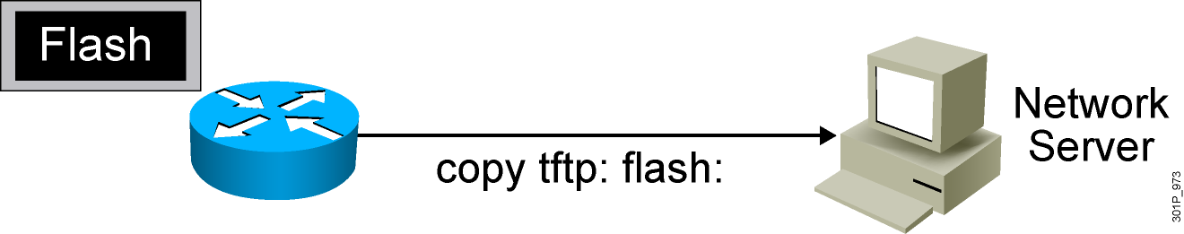
Creating a Software Image Backup
RouterX#copy flash tftp:
Source filename []? c2800nm-ipbase-mz.124-5a.bin
Address or name of remote host []? 10.1.1.1
Destination filename [c2800nm-ipbase-mz.124-5a.bin]
!!!!!!!!!!!!!!!!!!!!!!!!!!!! <output omitted>
12094416 bytes copied in 98.858 secs (122341 bytes/sec)
RouterX#
Back up current files prior to updating flash memory
Notes:
Purpose: This slide discusses how to create a backup version of a Cisco IOS software image to a TFTP server.
Emphasize: Routers by default come with Flash memory that has a preloaded copy of the Cisco IOS software. Although Flash is extremely reliable—good for 65 years and 100,000 rewrites—it is a good idea to make a backup copy of the Cisco IOS software if you have a TFTP server available. If you have to replace Flash memory for some reason, you will have a backup copy at the revision level currently running on your network.
The copy command screen output varies depending on the Cisco IOS software level.
Determine the platform type of your TFTP server prior to beginning the backup procedure. The TFTP server may be running Windows, UNIX, Mac, or other OS. Filename and directory access procedures may vary depending on the TFTP server platform and platform version.

Slide 17

Upgrading the Image from the Network
RouterX#copy tftp flash:
Address or name of remote host [10.1.1.1]?
Source filename []? c2800nm-ipbase-mz.124-5a.bin
Destination filename [c2800nm-ipbase-mz.124-5a.bin]
Accessing tftp://10.1.1.1/c2600-js-mz.122-21a.bin...
Erase flash: before copying? [confirm]
Erasing the flash filesystem will remove all files! Continue? [confirm]
Erasing device... eeeeeeeeee (output omitted) ...erased
Erase of flash: complete
Loading c2800nm-ipbase-mz.124-5a.bin from 10.1.1.1 (via Ethernet0/0): !!!!!!!!!
(output omited)
[OK - 12094416 bytes]
Verifying checksum... OK (0x45E2)
12094416 bytes copied in 120.465 secs (100398 bytes/sec)
RouterX
Notes:
Purpose: This slide describes how to load a backup version of a Cisco IOS software image from a TFTP server to the router.
Emphasize: If you need more Flash space to load a copy of the Cisco IOS software, you must first erase the Flash memory. You cannot erase a single image—you must erase all copies of Cisco IOS software from Flash. However, if Flash memory on the router is partitioned, you can erase one or more of the parts.
After the TFTP transfer is completed, use the show flash command to view the file size to compare its size with that of the original on the server.
If the Cisco IOS is running from Flash, then the Flash is in the read-only state. To change the Flash to a writeable state, you can use the boot system TFTP command to boot a Cisco IOS from a TFTP server and the Cisco IOS will be run from RAM, or you can go to the Rxboot mode to perform the copy.

Slide 18
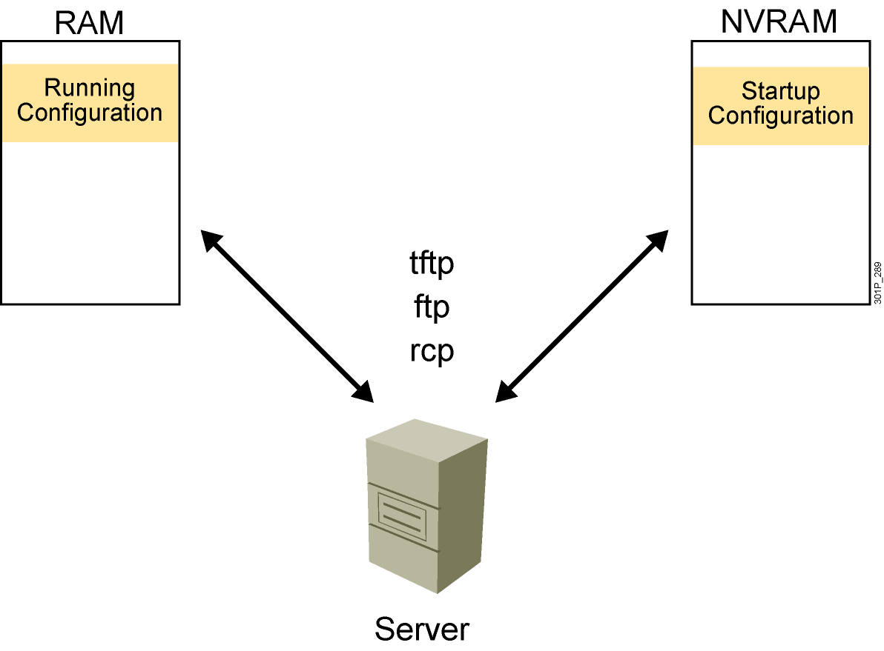
Device Configuration Files

Slide 19
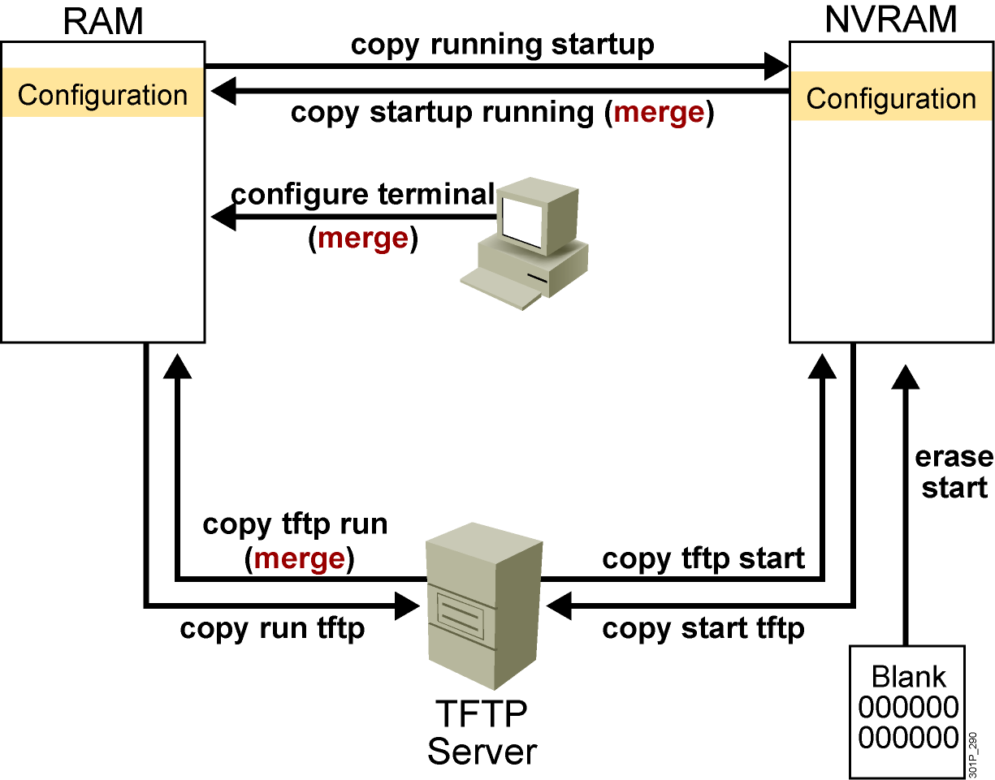
Cisco IOS copy Command
  NVRAM
  Terminal
  TFTP server
  Erase start
Notes:
Layer 4 of 4

Slide 20
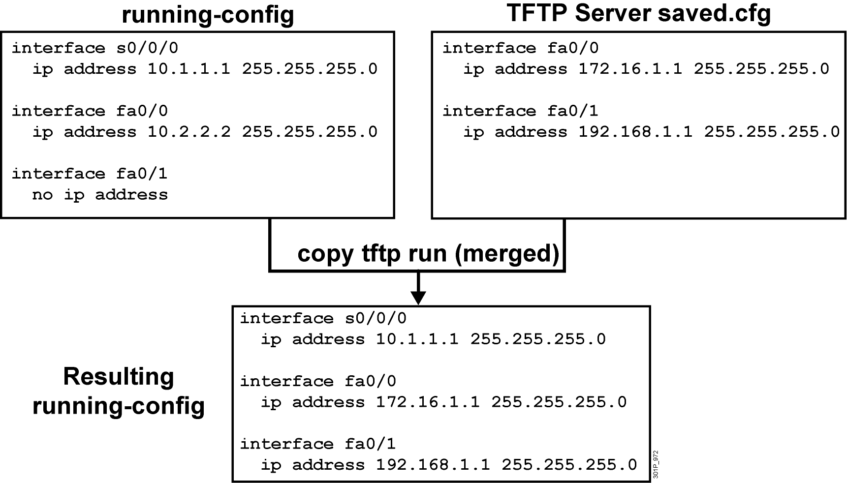
Cisco IOS copy Command Example
Notes:
Note: Cisco IOS Release 12.0 supports a new syntax for the copy command.

Slide 21
copy run tftp and copy tftp run Commands
RouterX#copy running-config: tftp:
Address or name of remote host []? 10.1.1.1
Destination filename [running-config]? wgroa.cfg
.!!
1684 bytes copied in 13.300 secs (129 bytes/sec)
RouterX#copy tftp: running-config:
Address or name of remote host []? 10.1.1.1
Source filename []? wgroa.cfg
Destination filename [running-config]?
Accessing tftp://10.1.1.1/wgroa.cfg...
Loading wgroa.cfg from 10.1.1.1 (via Ethernet0): !
[OK - 1684/3072 bytes]
1684 bytes copied in 17.692 secs (99 bytes/sec)
Notes:
Note: Cisco IOS Release 12.0 supports a new syntax for the copy command.

